Slide 1
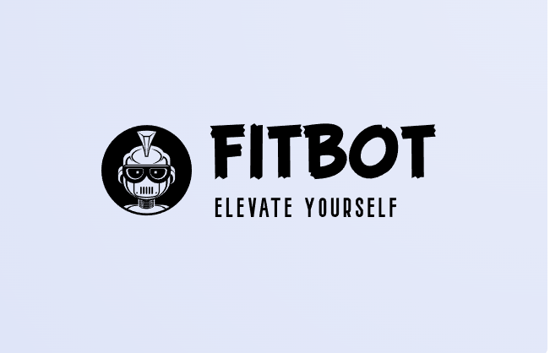

Slide 2

INTRODUCTION
THEME: NLP TOOLS(CHAT BOT) USING GOOGLE DIALOGLOW
DOMAIN: HEALTHCARE
BATCH NO: 24 (CSE-AIML)
TEAM MEMBERS:
M.Sai Charan Reddy(2451-22-748-040)
R.Neetish Reddy(2451-22-748-006)
P.Abhinav(2451-22-748-014)
GUIDE: DR.Namitha

Slide 3
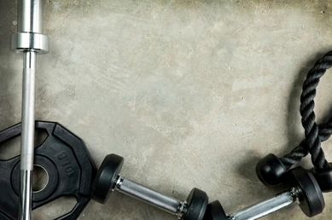
PROBLEM OF THE PROJECT
"Many individuals struggle to maintain consistent health and fitness routines due to the lack of accessible, personalized, and reliable support.
The project "Chatbot for Health and Fitness" aims to develop a personalized, AI-powered chatbot to help users maintain and improve their health and fitness routines.

Slide 4
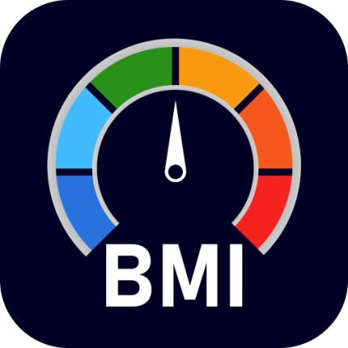
SCOPE OF THE PROJECT
The FITBOT finally aims to provide the diet plan for various goals and provide mental and reasoning support to nurture and elevate their body.
Thereby FITBOT help you to calculate the bmi and able to answer to all the health and fitness related queries raised by user.

Slide 5
Application areas-
Users-
Health Management:
-Monitor and manage daily health metrics or a healthier lifestyle.
Fitness and Wellness Tracking:
-log and track exercise routines to maintain itness goals
Calculate BMI and calorie intake:
-calculate body mass index and calorie and help you to make your personalised diet
General Public:
-user can raise any queries and get solutions or their queries.
Athletes :
-to monitor the bmi and calaorie intake
Pregnant women:
-helps to monitor the physical health of pregnant women.

Slide 6

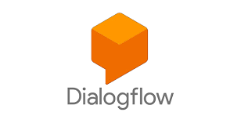


Tools and technologies used in the project:
Frontend:
HTML: Structure of the web pages
CSS: Styling and layout(including frameworks like font background image).
JavaScript: Dynamic interactions and functionality.
Backend:
Node.js: Server-side scripting
Express.js:web framework for Node.js to handle routes and server logics.
3.NLP tools(Google API’s):
Google dialogflow is used to create the intent and responses
4.Firebase and Google cloud:
Used for calculations for task like BMI.
5.TOOLS:
IDE:Visual Studio Code

Slide 7

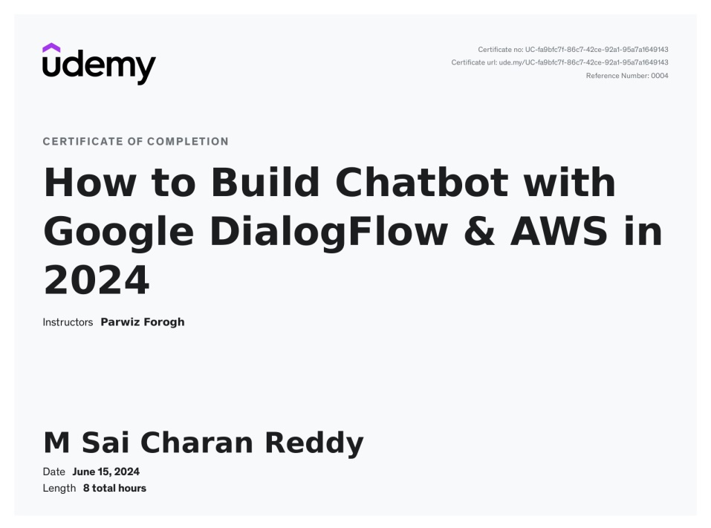
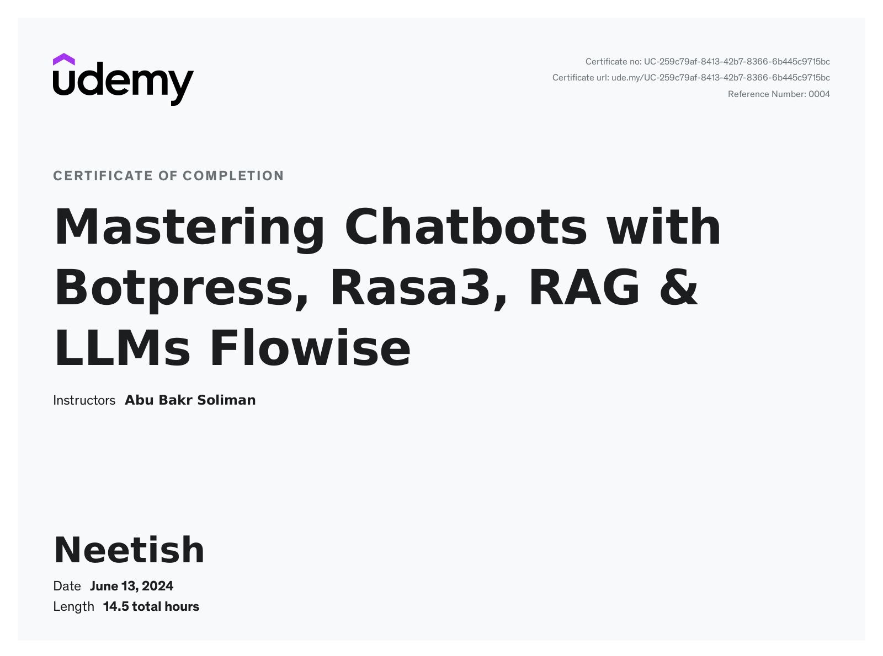
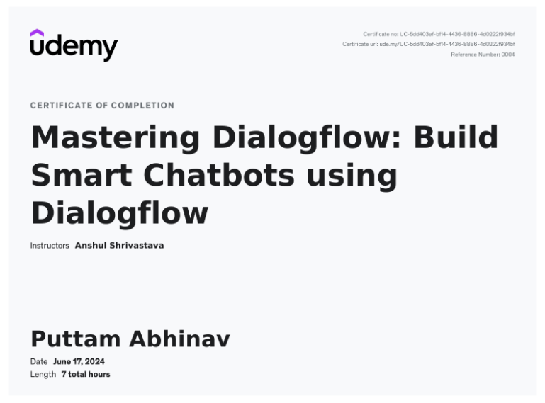
Certification-
We have done courses on NLP platforms (botpress,Google Dialogflow) by udemy.

Slide 8

I/O Specification
INPUT:
User queries ,Greetings,the required details or calculations
OUTPUT:
Answers to the queries raised, calculation solution,Diet chart.

Slide 9
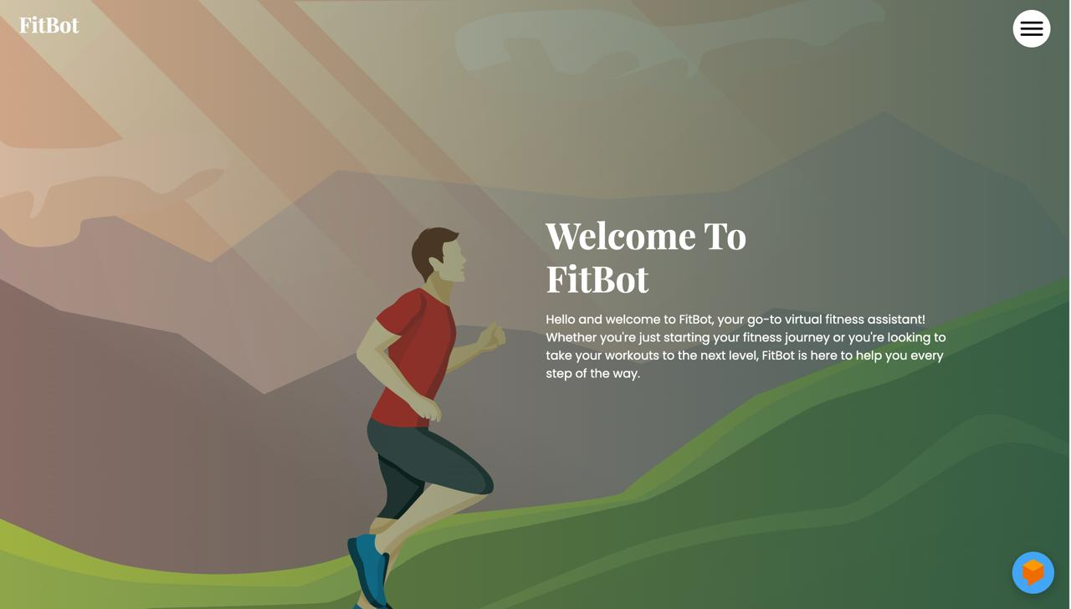
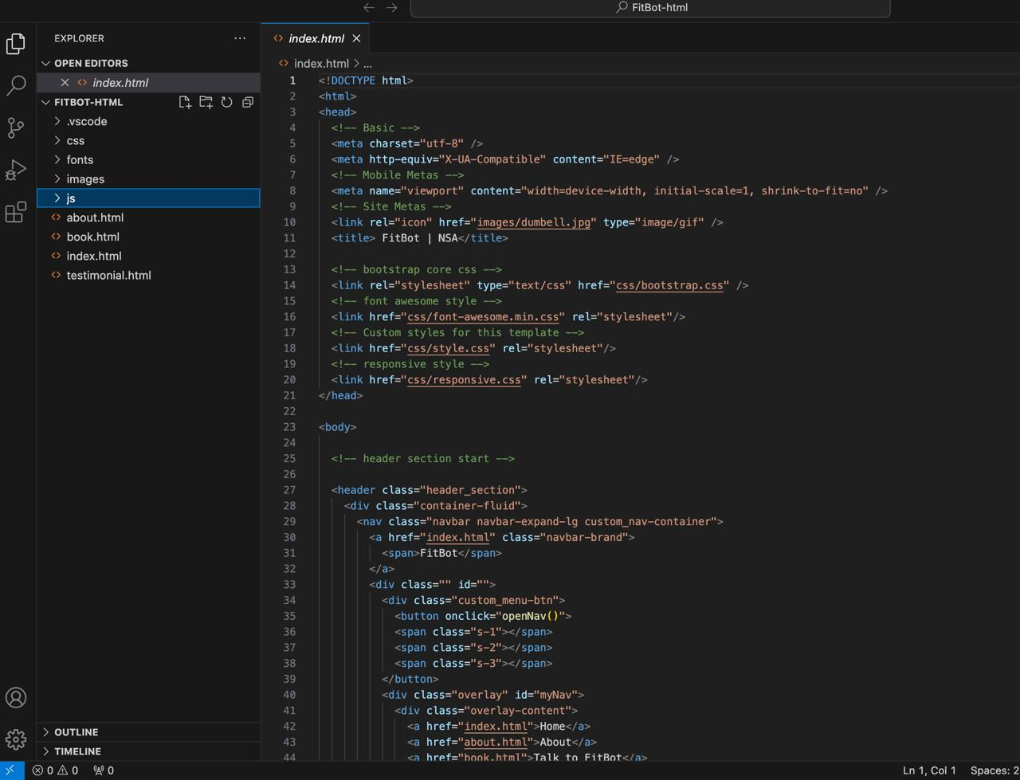
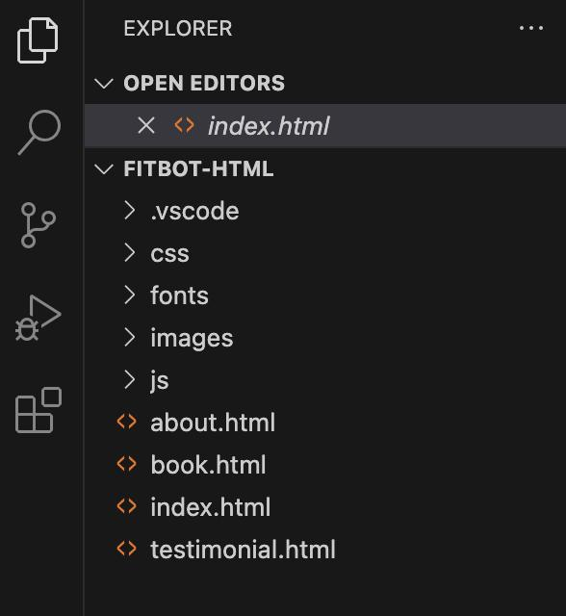
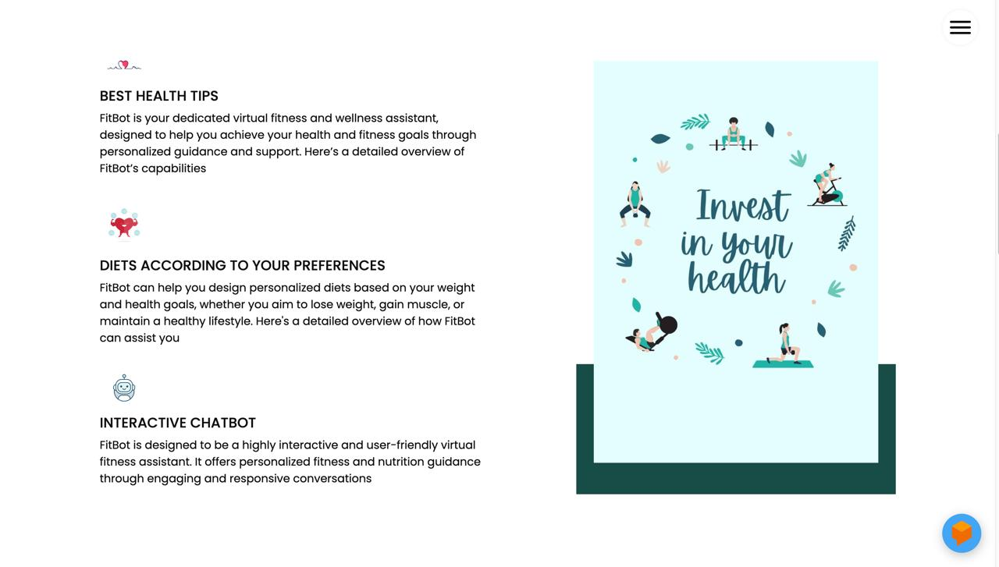
IMPLEMENTATION
Using HTML,CSS,JS we have created a website with required styles and inserted few information.

Slide 10
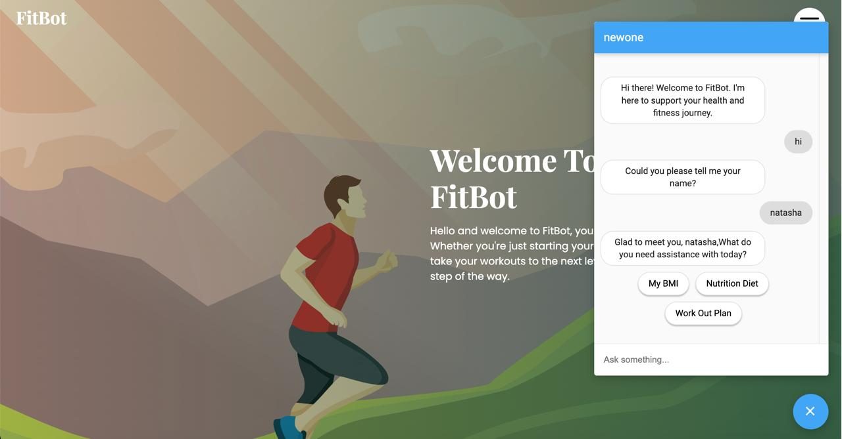
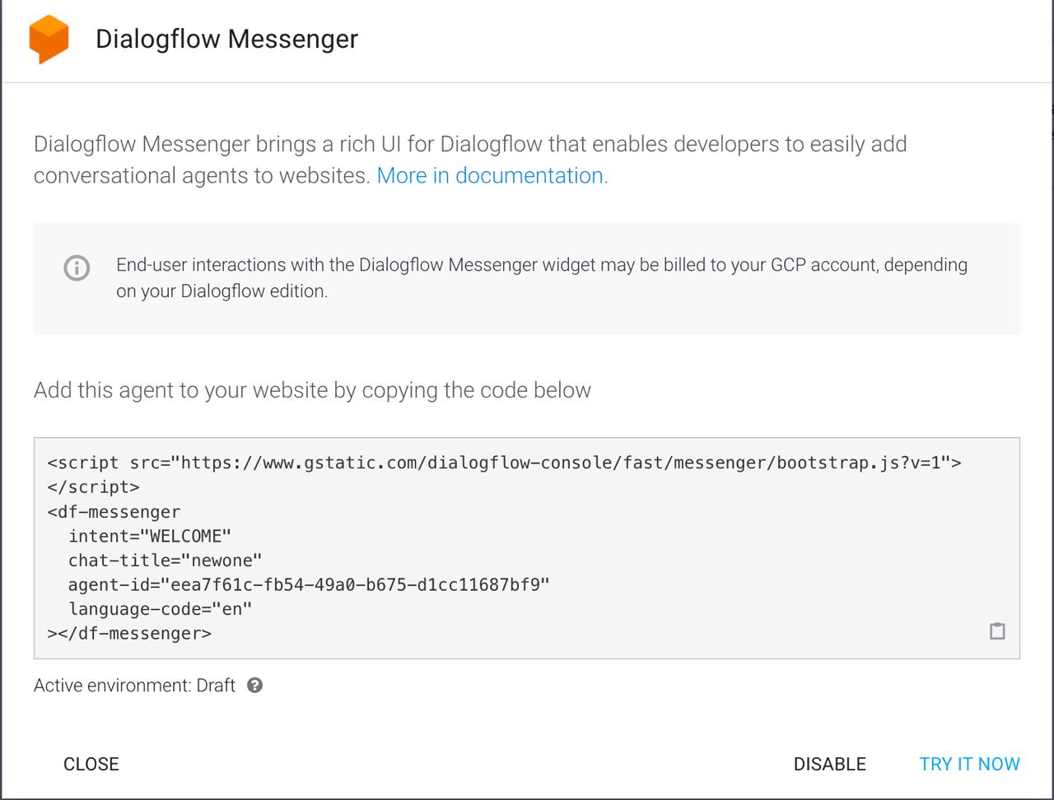
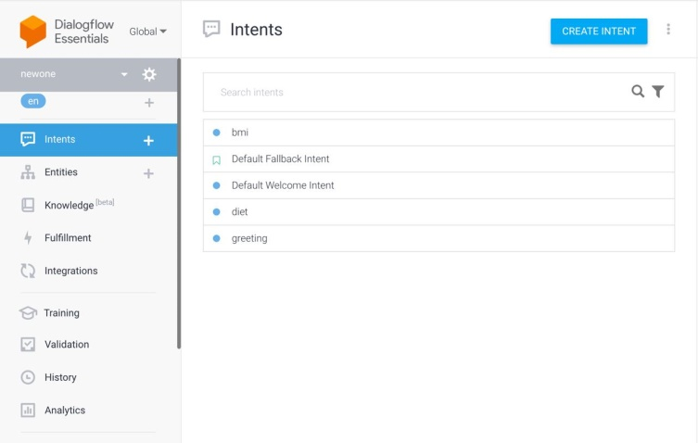
IMPLEMENTATION
We have created a chatbot using Google API(DIALOGFLOW) and connected the google dialogflow to the website and a fitbot is reflected on the website

Slide 11
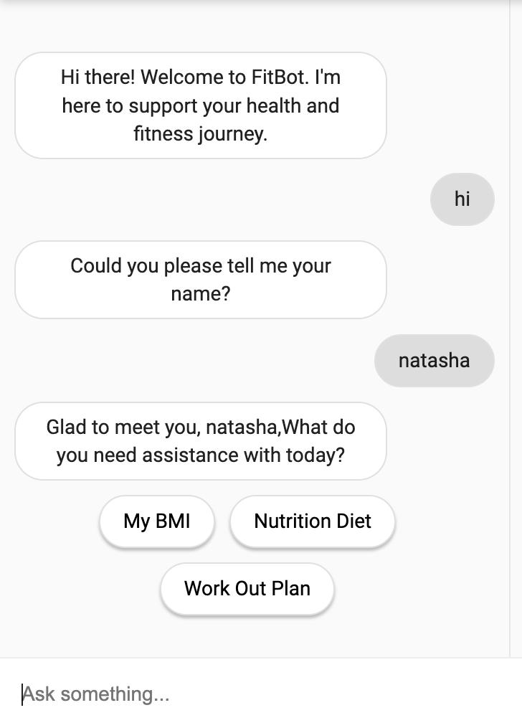
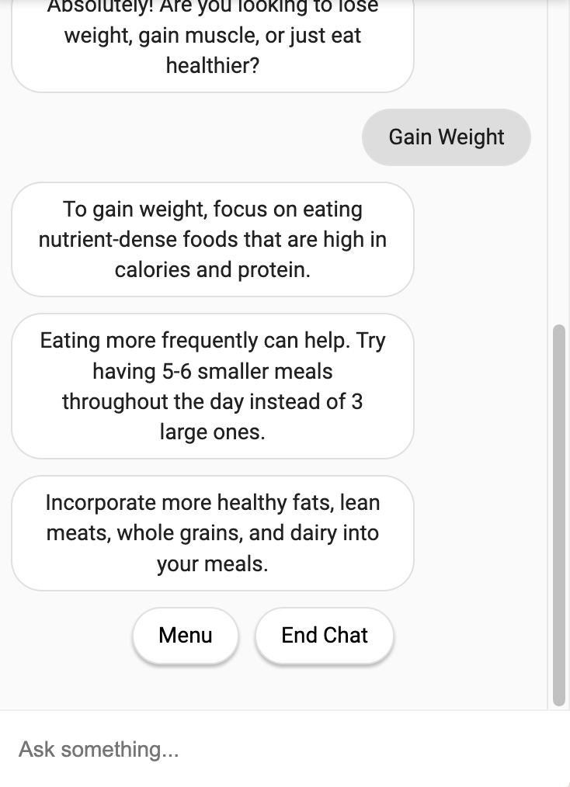
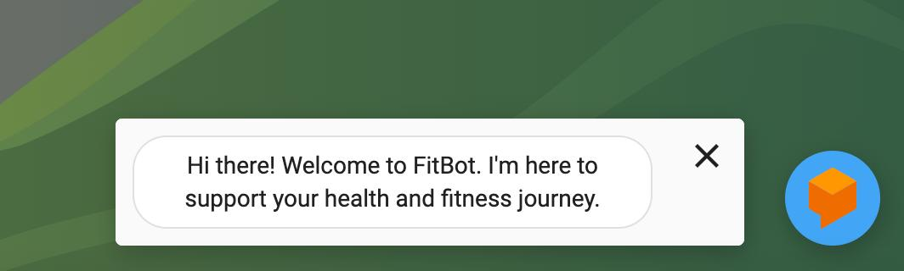
RESULTS

Slide 12
Conclusion and Future Enhancement
Provide you a virtual support for your daily workout routine.
changing your diet according to your Workout plan.
Helps you in calculating your calorie intake.
Focuses on preventing health risk diseases and helps in maintaining healthy lifestyle.
Provide you complete solution to the various queries raised in a simpler way.

Slide 13




References

Slide 14

NO MORE EXCUSES
ELEVATE AND NURTURE YOUR BODY .
THANK
YOU

